Slide 1


BDAT 1007 Social Data Mining Techniques Assignment #2
Harmilap Singh Dhaliwal

Slide 2
Table of Contents
Tools and Techniques Used
Data Model
Social media data scraping (API)
Web Application

Slide 3

Tools and Techniques

Slide 4


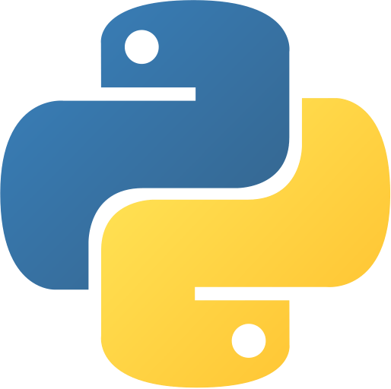


Tools and Techniques used
Tweepy
Mongo DB ATLAS
To Scrape Data from twitter using API
Is used as a cloud database storage
To Scrape Data from reddit using API
PRAW
Python microframework to build backend of our app
FLASK

Slide 5




Tools and Techniques used (Cont.)
JavaScript
CSS
For dynamic elements of our web app
For better design, used in frontend
HTML
For the structure and skeleton of our web app
AJAX
Used to get data from frontend to backend

Slide 6




Tools and Techniques used (Cont.)
jQuery
Tiny MCE
In lieu with AJAX, used to get data from frontend to backend
Editor for posting messages on Social Media
To get beautiful design, used extensively
To display our data.
BOOTSTRAP
Data tables

Slide 7

Data Model

Slide 8
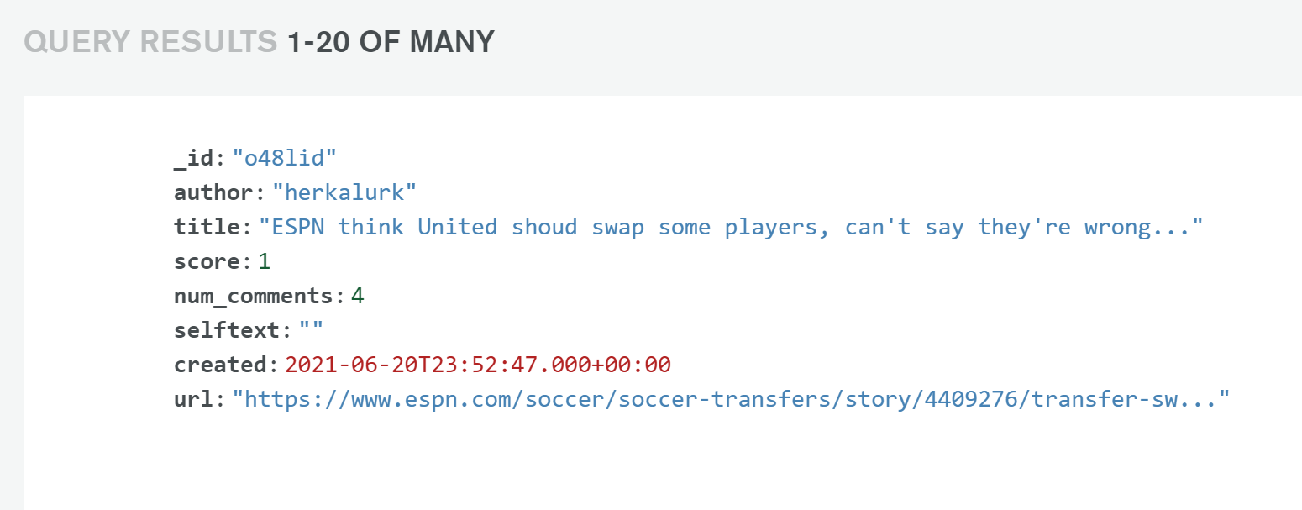
Data Model ( )
Sr.No. | Variable Name
1 | Time Created
2 | Author
3 | Title
4 | Score
5 | Number of Comments
6 | Post
7 | Link

Slide 9

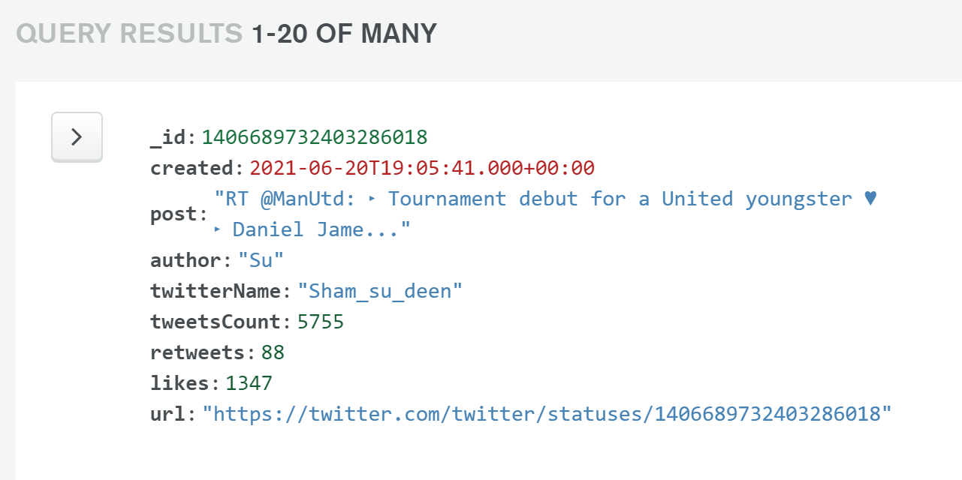
Data Model ( )
Sr.No. | Variable Name
1 | Time Created
2 | Author
3 | Twitter Name
4 | Likes
5 | Retweets
6 | Post
7 | Number of Tweets
8 | Link

Slide 10
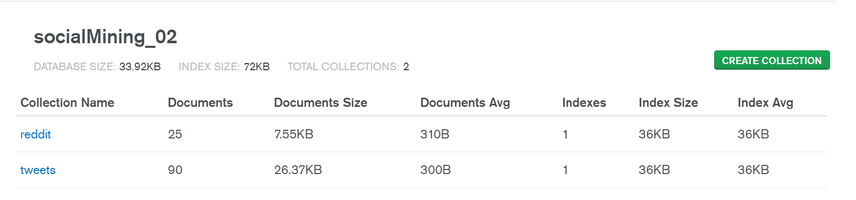
Mongo db Database

Slide 11


Social media data scraping (API)

Slide 12
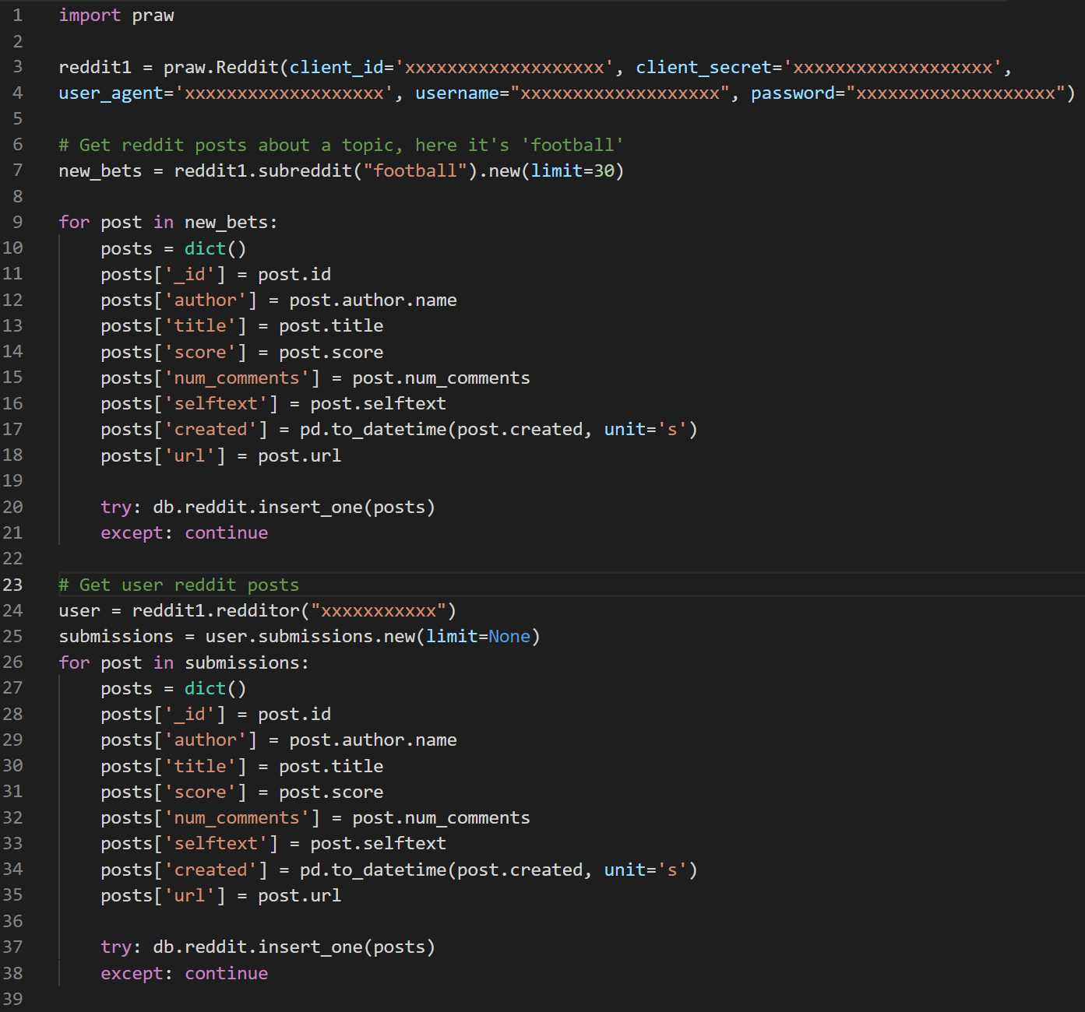
Scraping reddit using api and praw

Slide 13
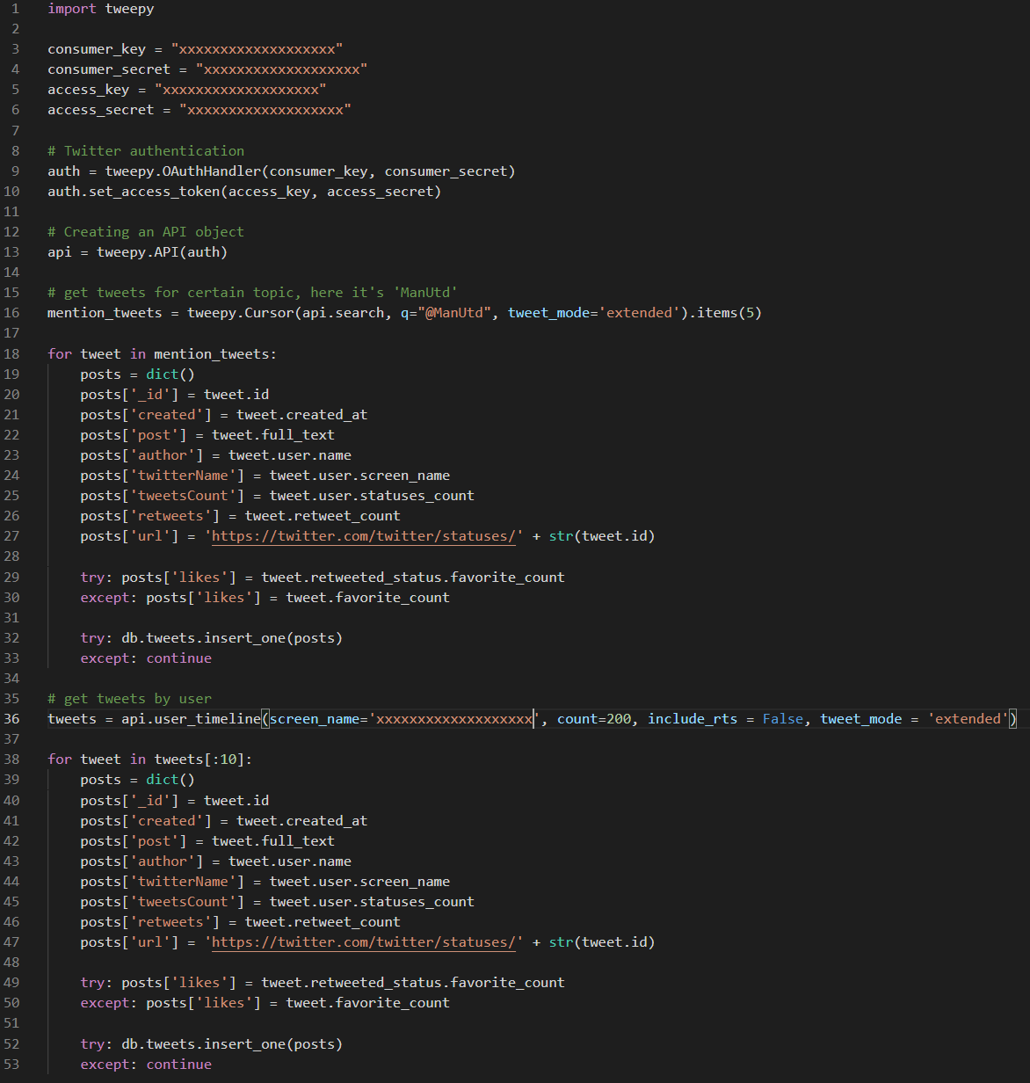
Scraping Twitter using api and Tweepy

Slide 14
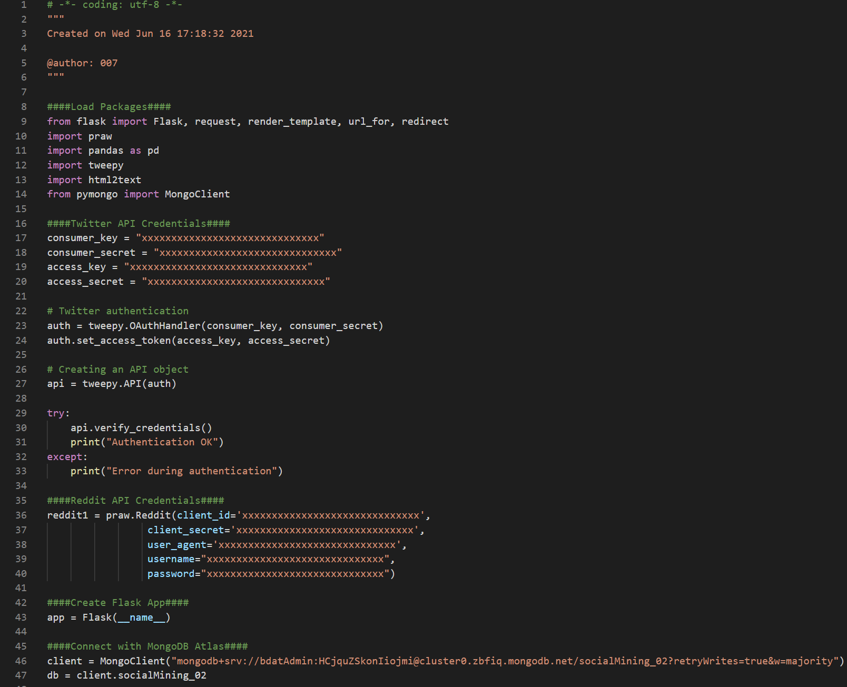
Complete flask backend code

Slide 15
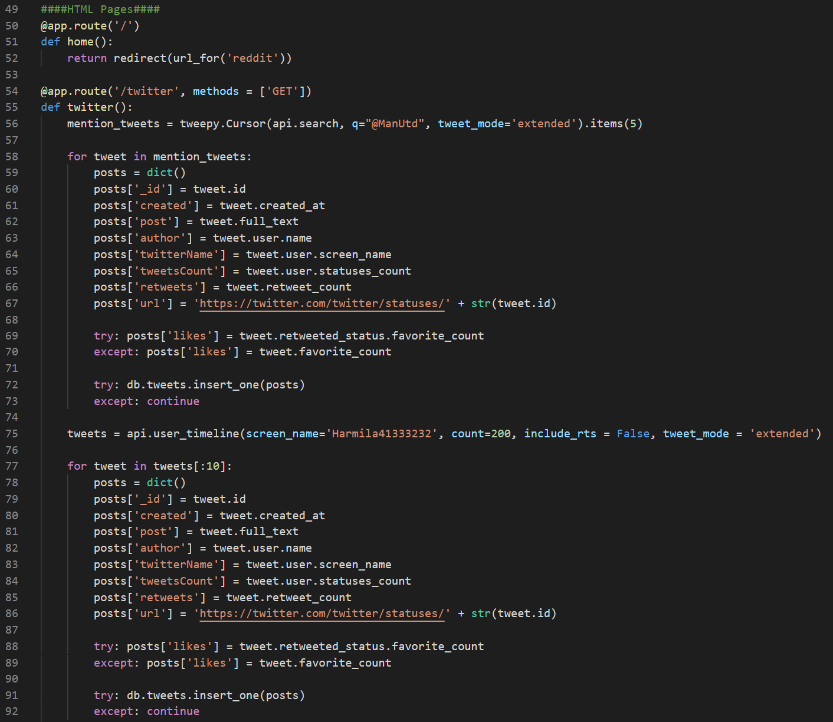
Complete flask backend code

Slide 16
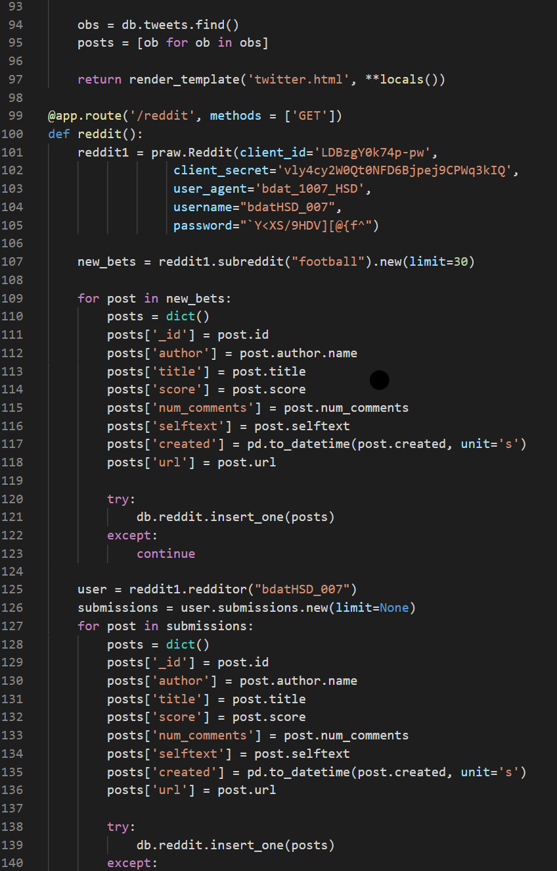
Complete flask backend code

Slide 17
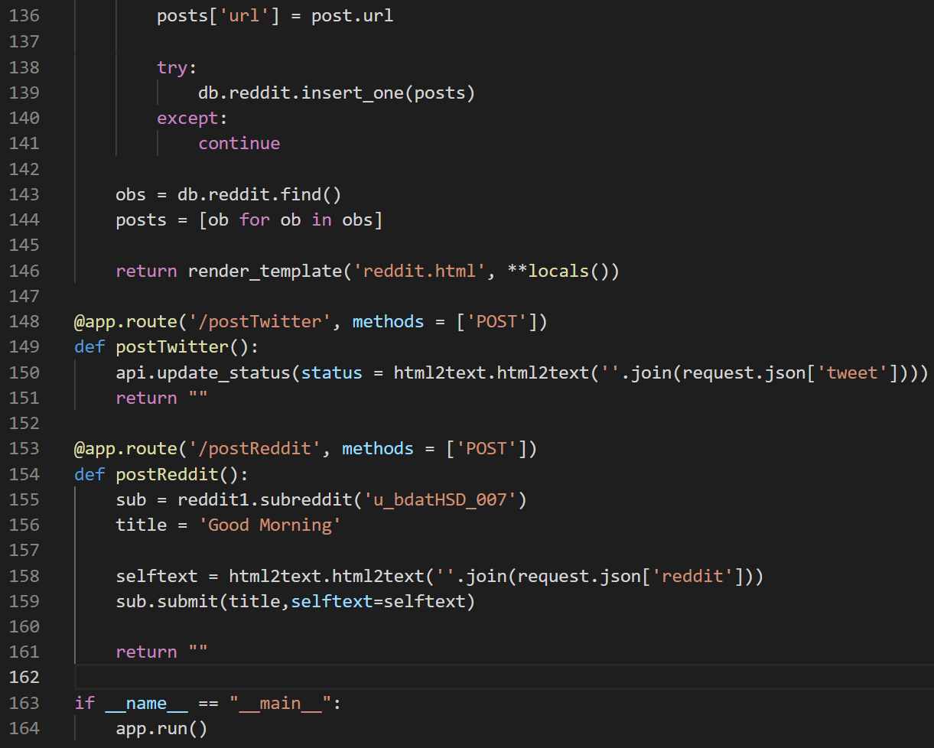
Complete flask backend code

Slide 18

Web application

Slide 19
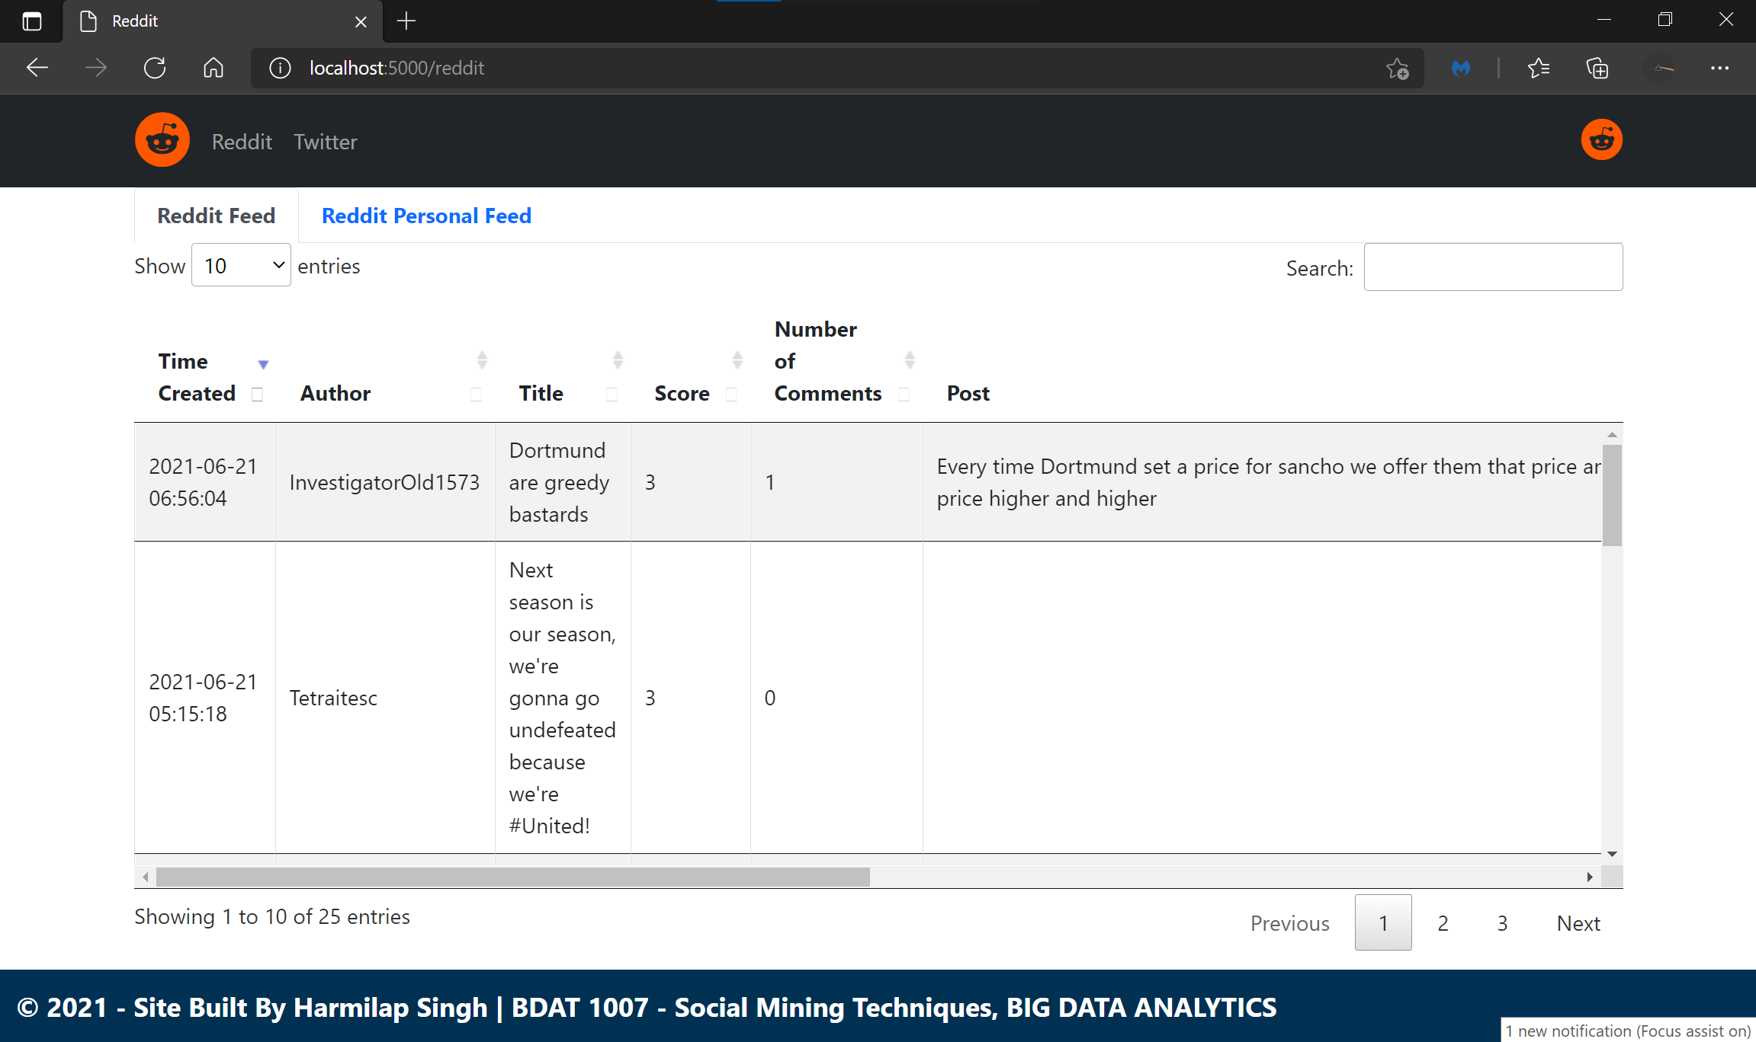
Web design elements
Bootstrap navbar
Tinymce editor
Datatables table
Bootstrap navbar

Slide 20
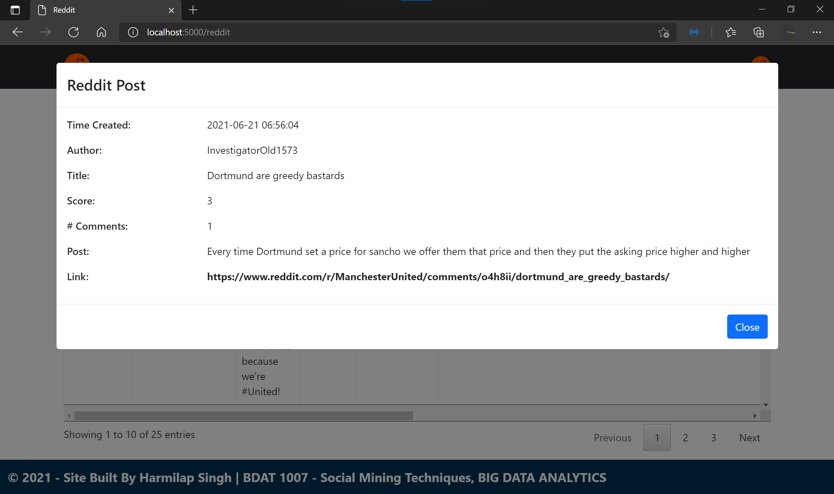
Web design elements
Booststrap on click modal

Slide 21
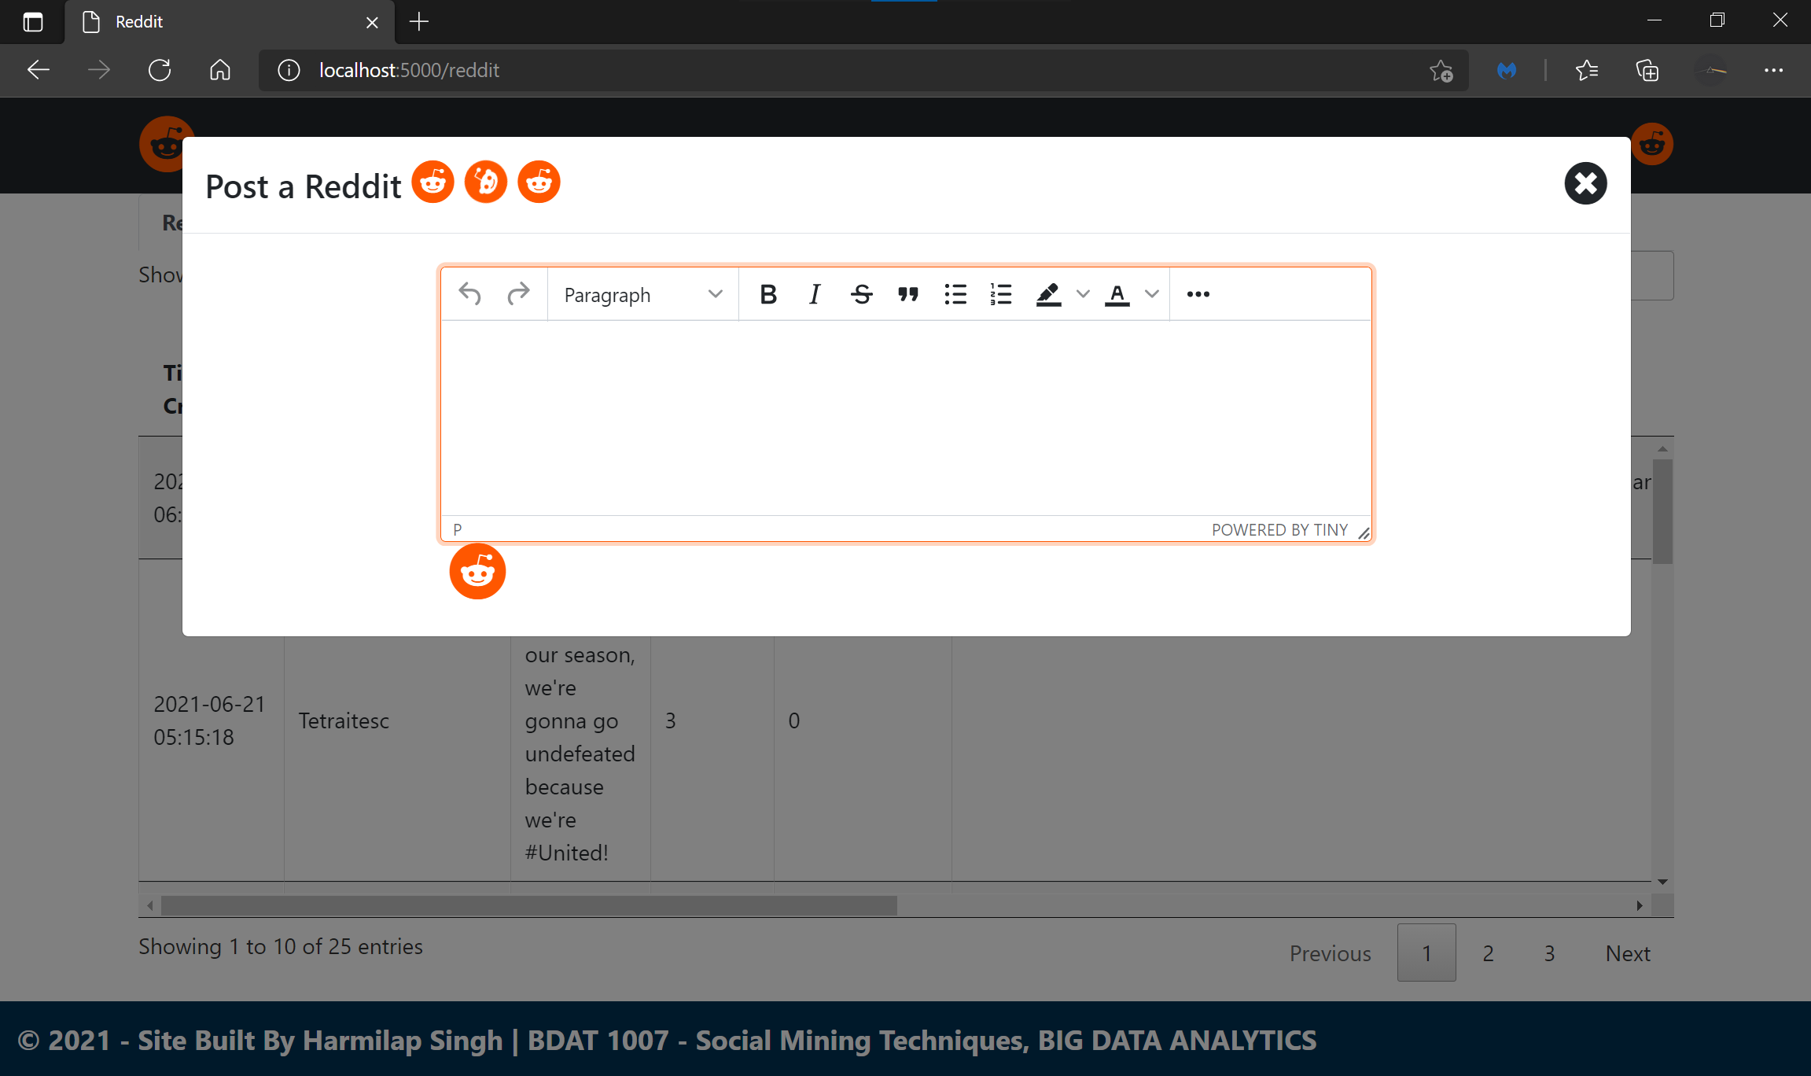
Web design elements
Tinymce editor inside a bootstrap modal

Slide 24
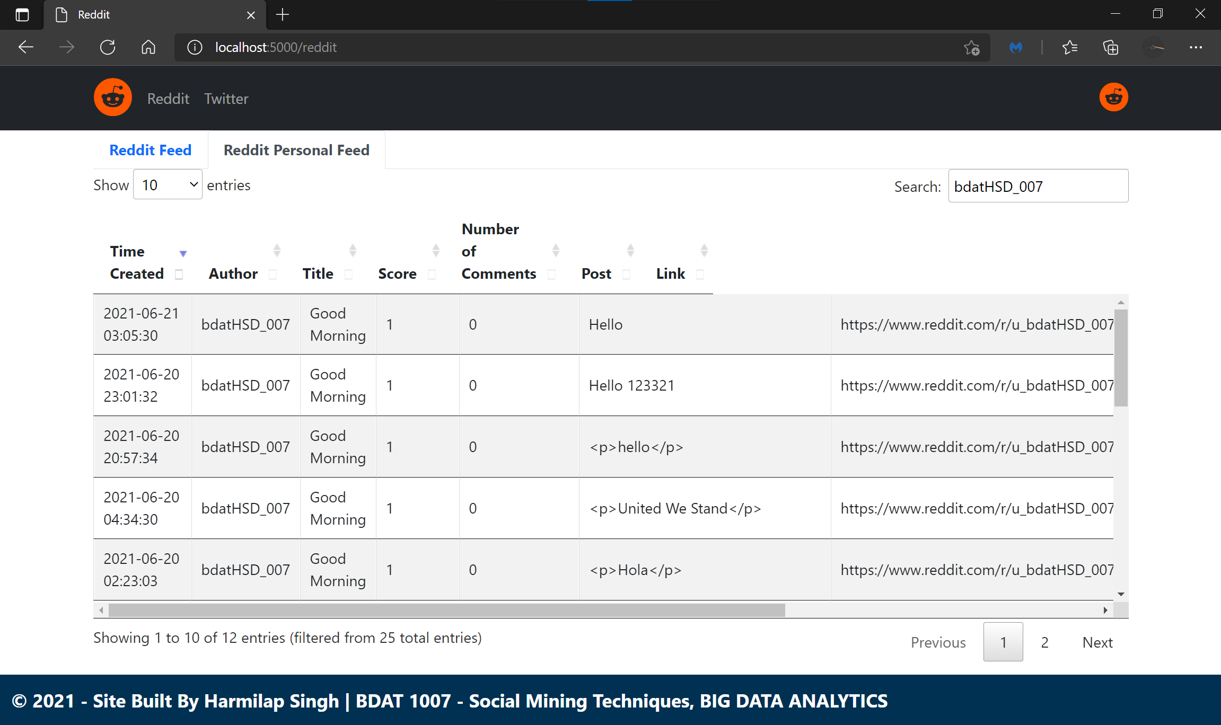

Slide 25
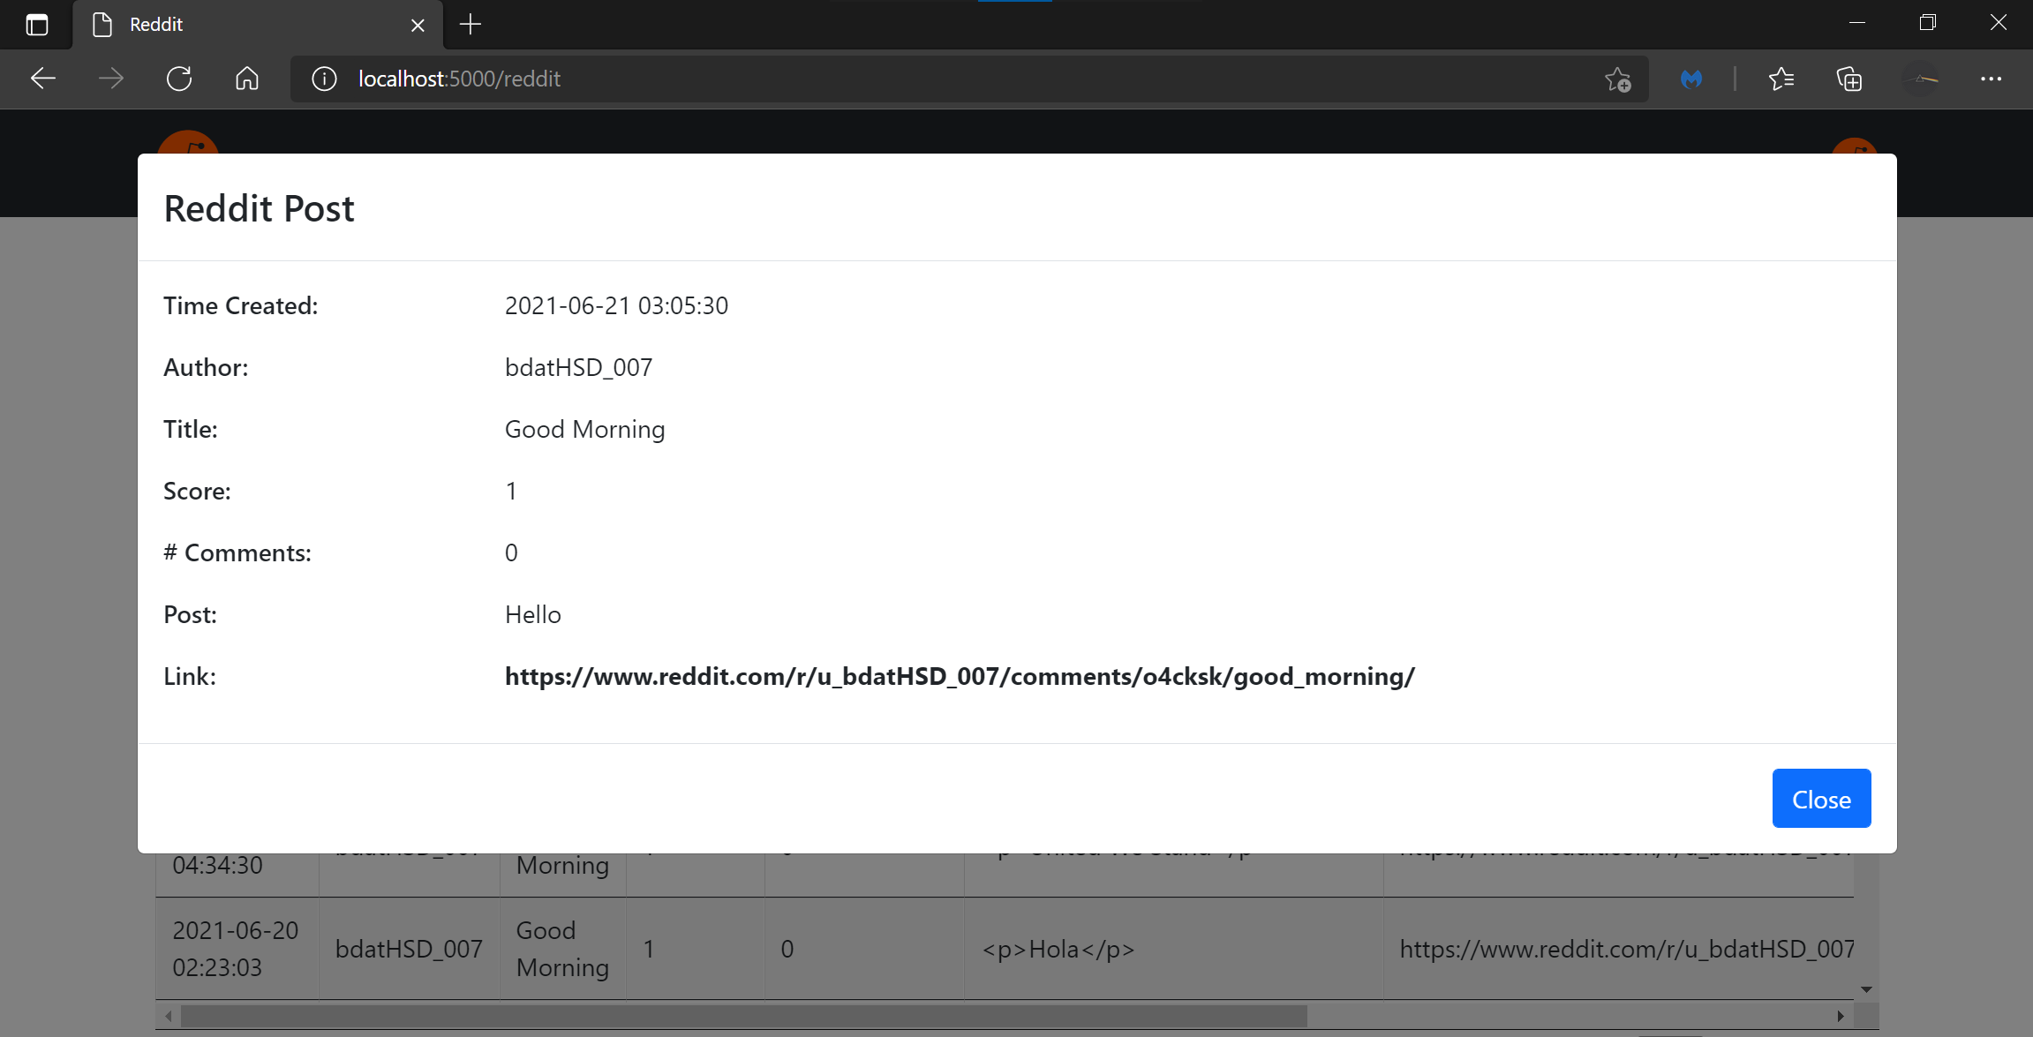

Slide 27
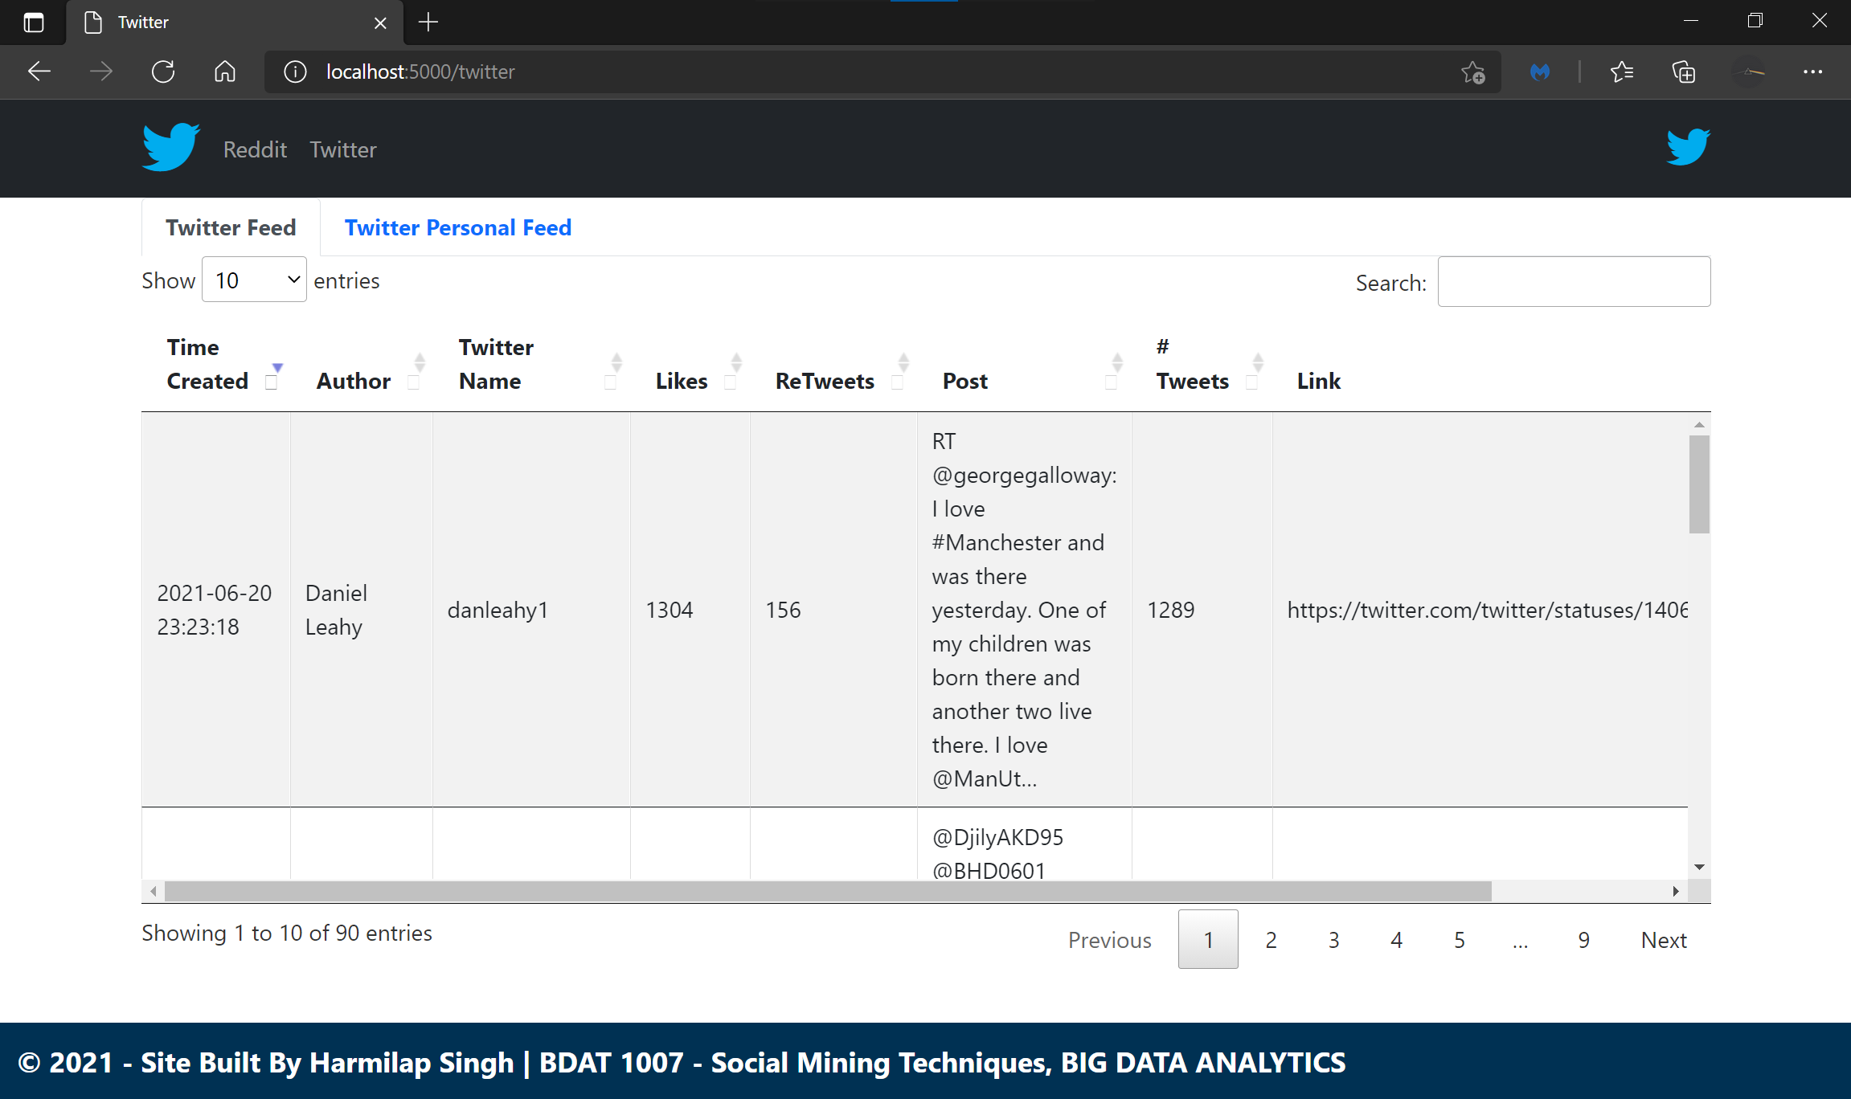

Slide 28
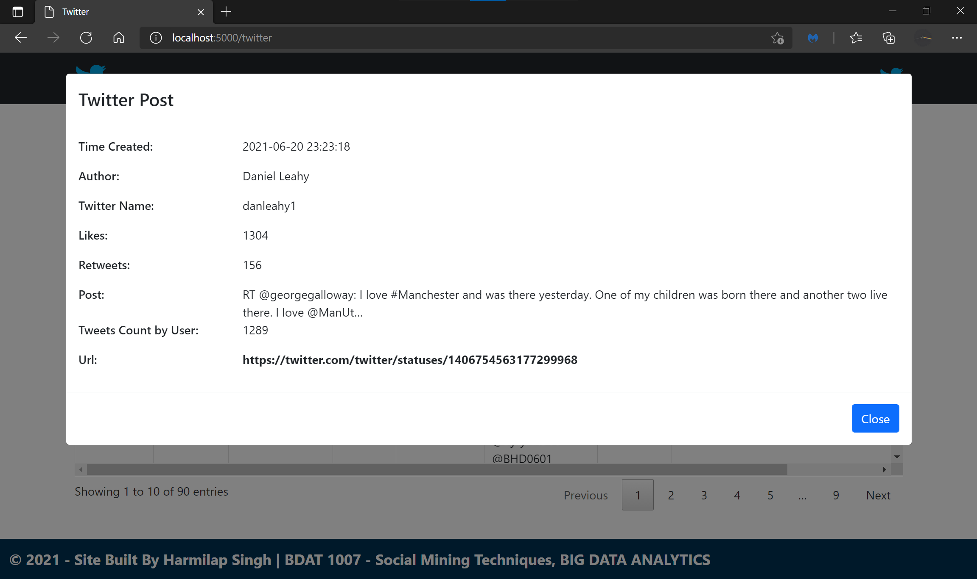

Slide 29
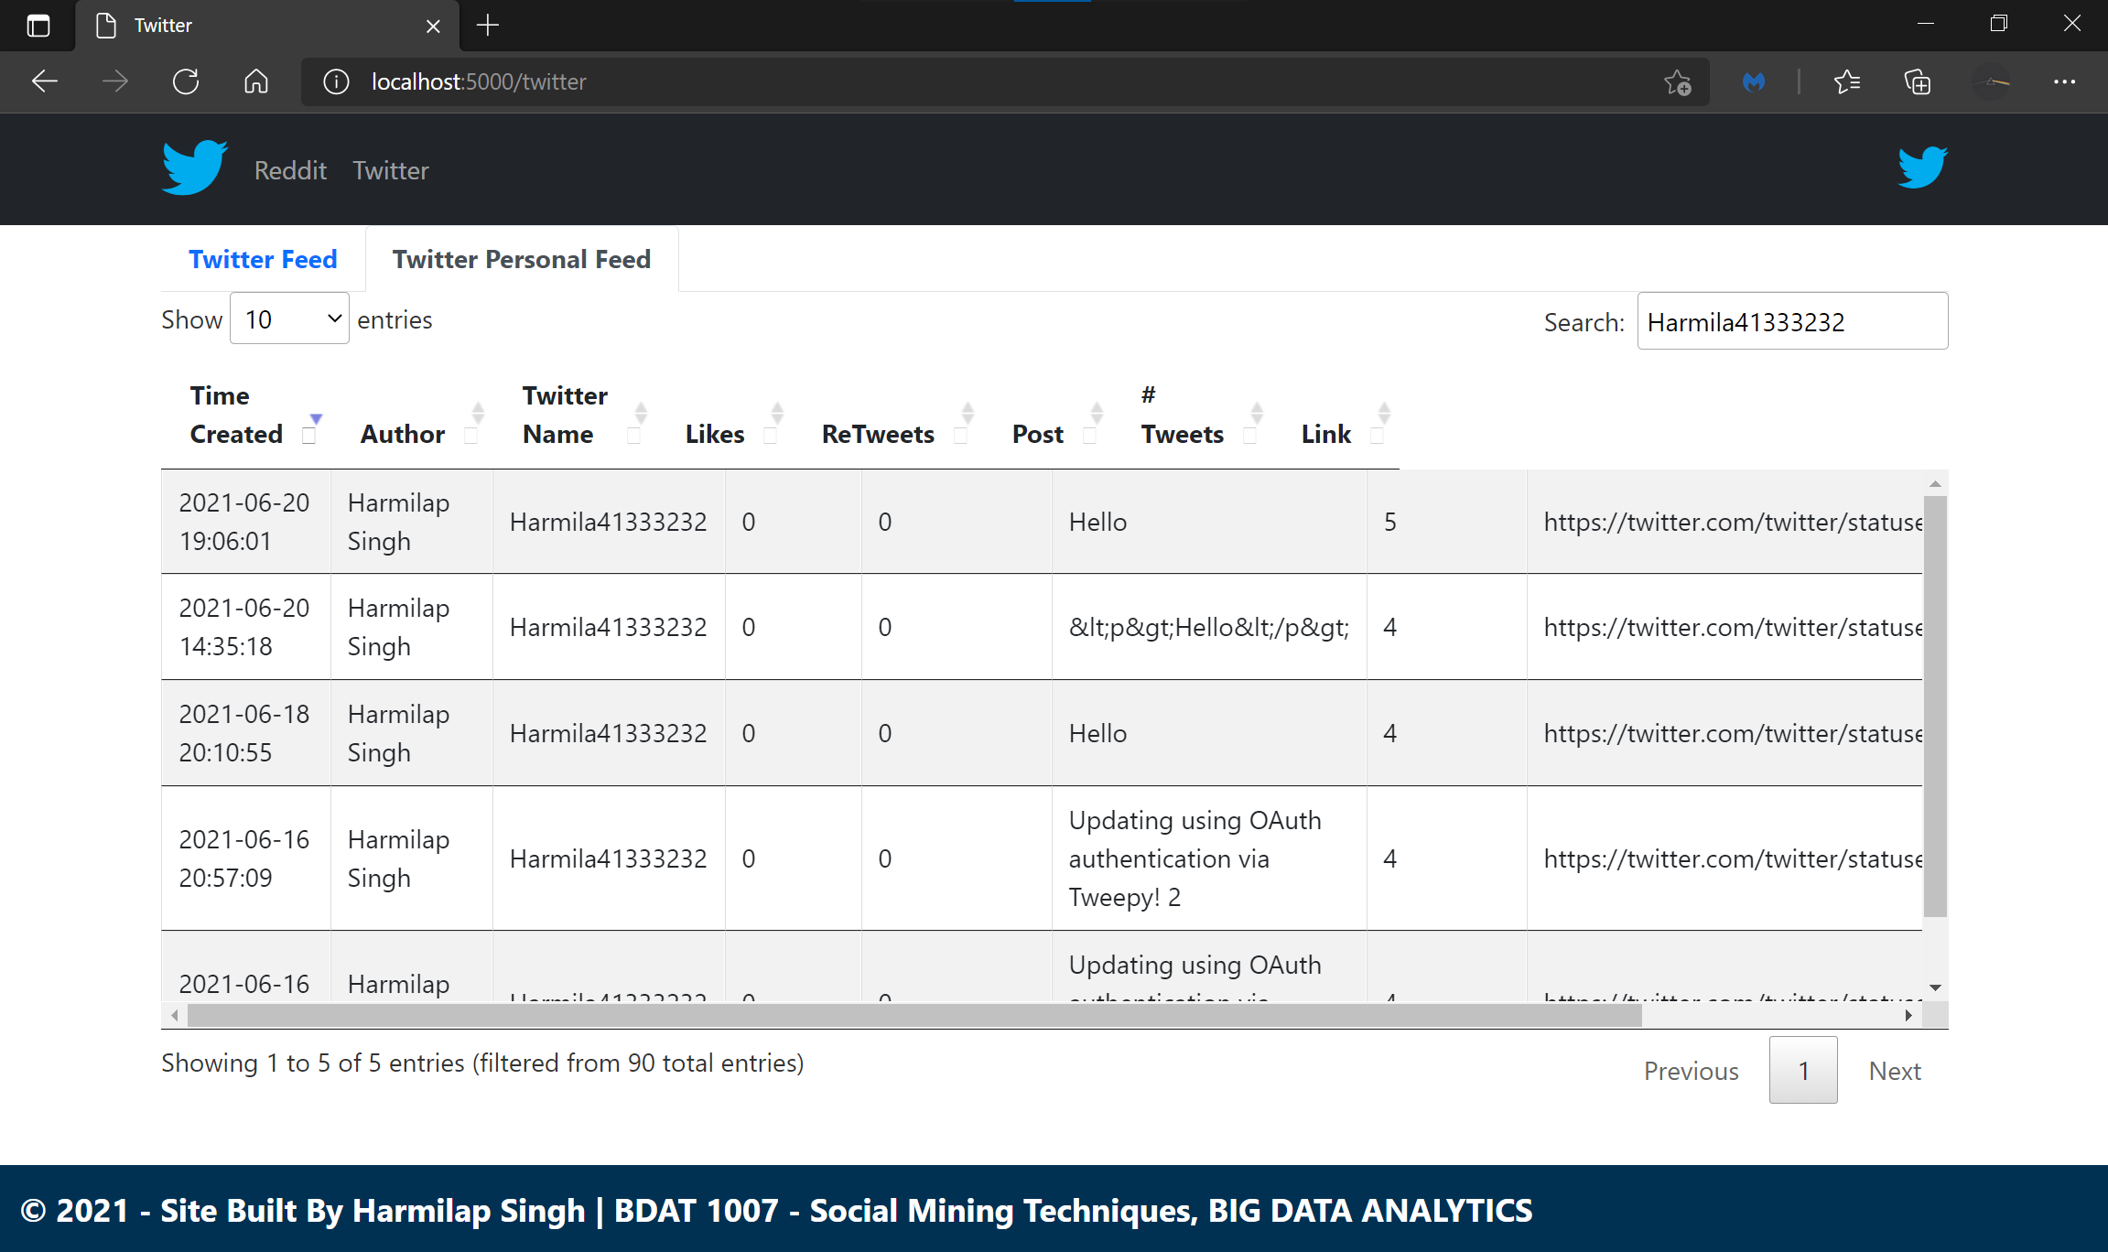

Slide 30
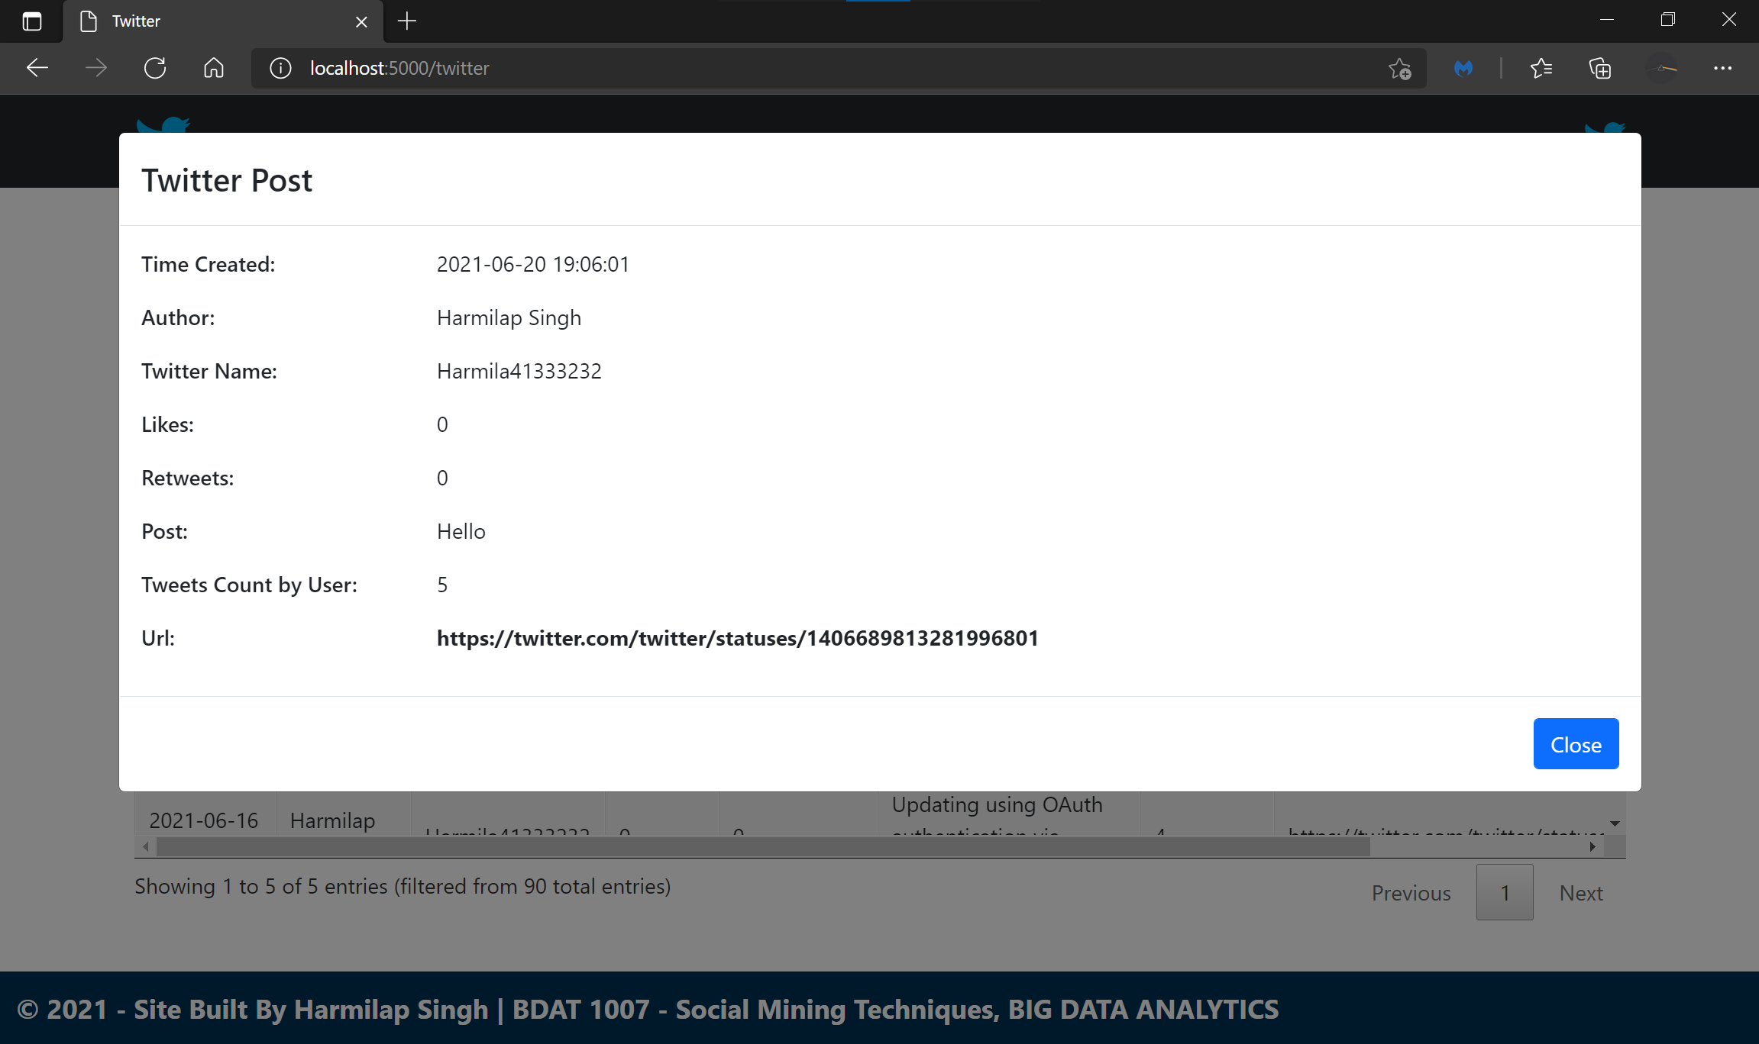

Slide 31
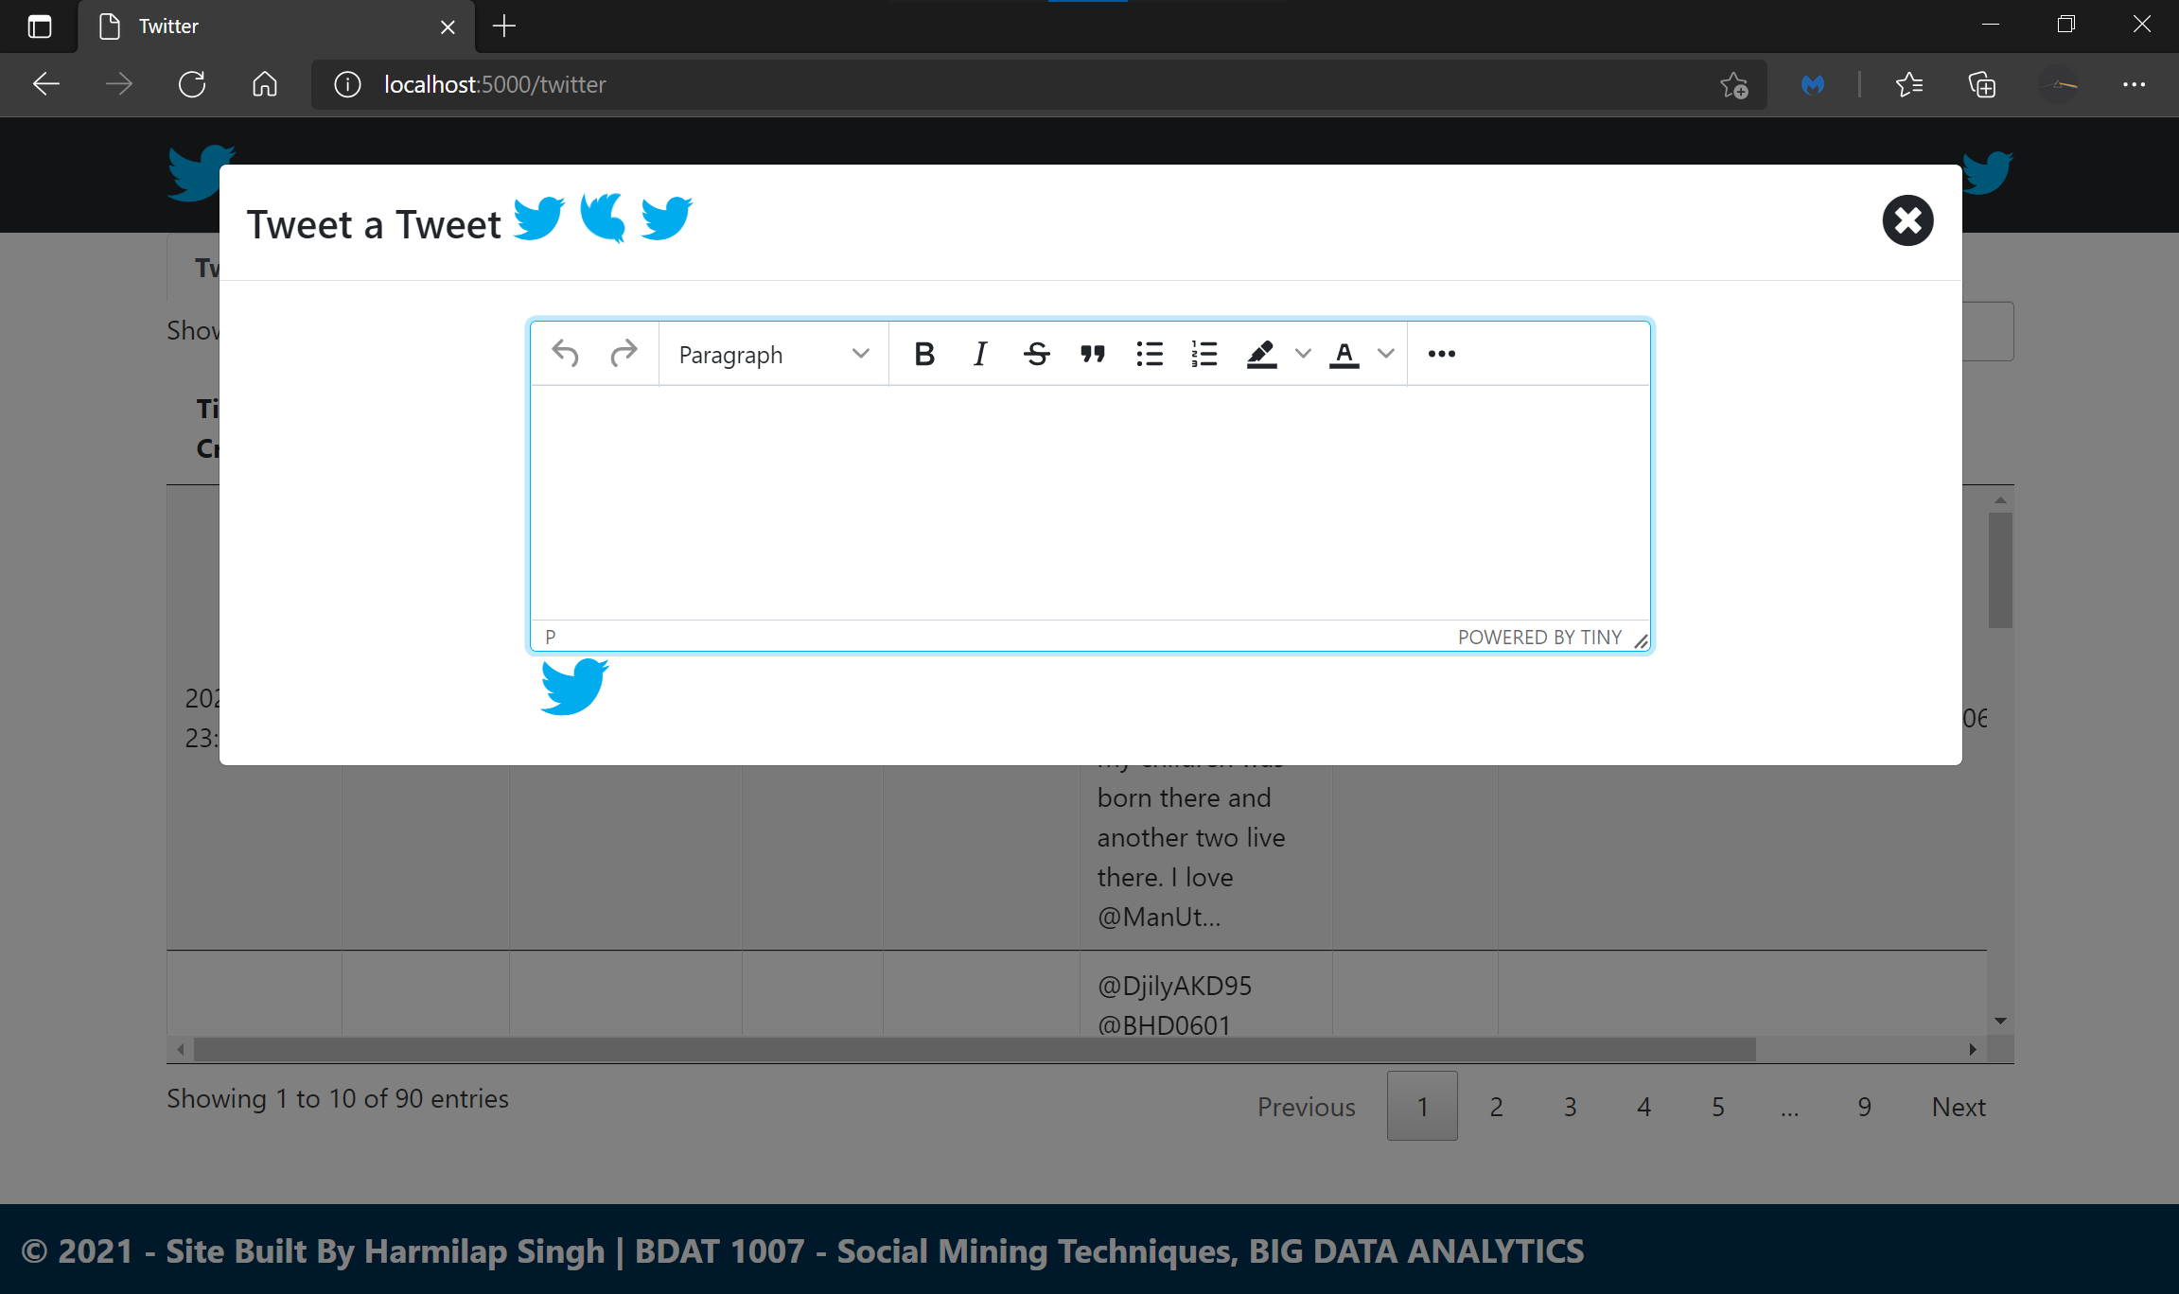

Slide 32
Resources & References
Open bootstrap modal pop on datatable row click event – Therichpost
How to scrape Reddit with Python – Storybench
Post on Reddit API With Python (PRAW) - JC Chouinard
How to Make a Twitter Bot in Python With Tweepy – Real Python
Bootstrap WYSIWYG editor - Enhance your Bootstrap form inputs with rich text (tiny.cloud)

Slide 33
YouTube link
https://youtu.be/P4Oph4dsVrQ

Slide 34

THANK YOU

